Slide 1
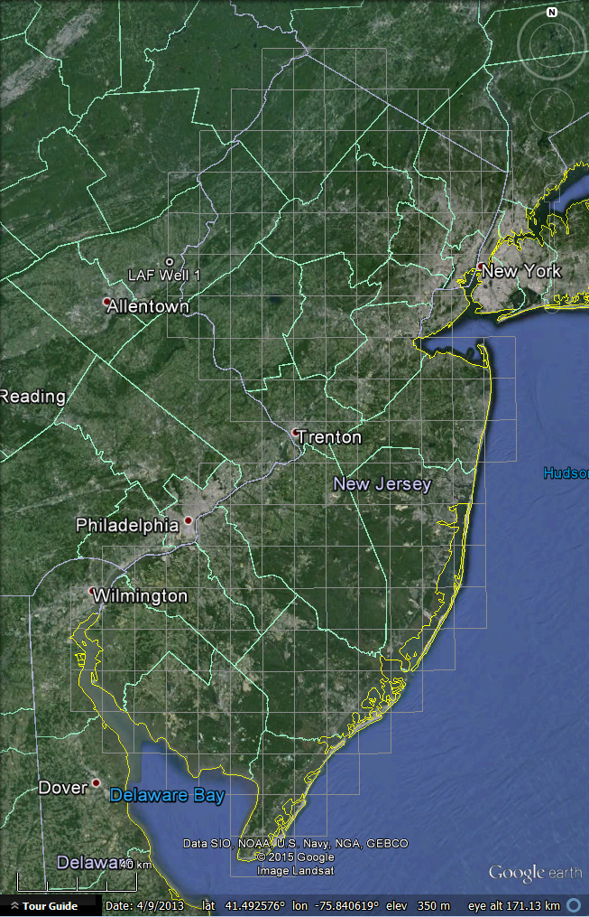
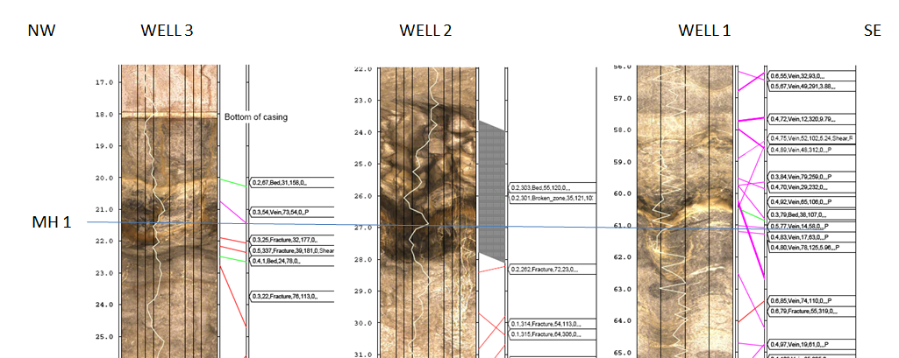
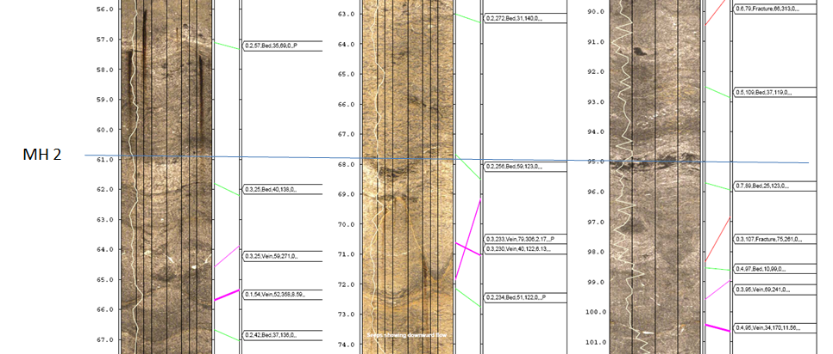
Lafayette College Well-field Analysis
G.C. Herman
NJ Geological & Water Survey
November, 2015

Slide 2
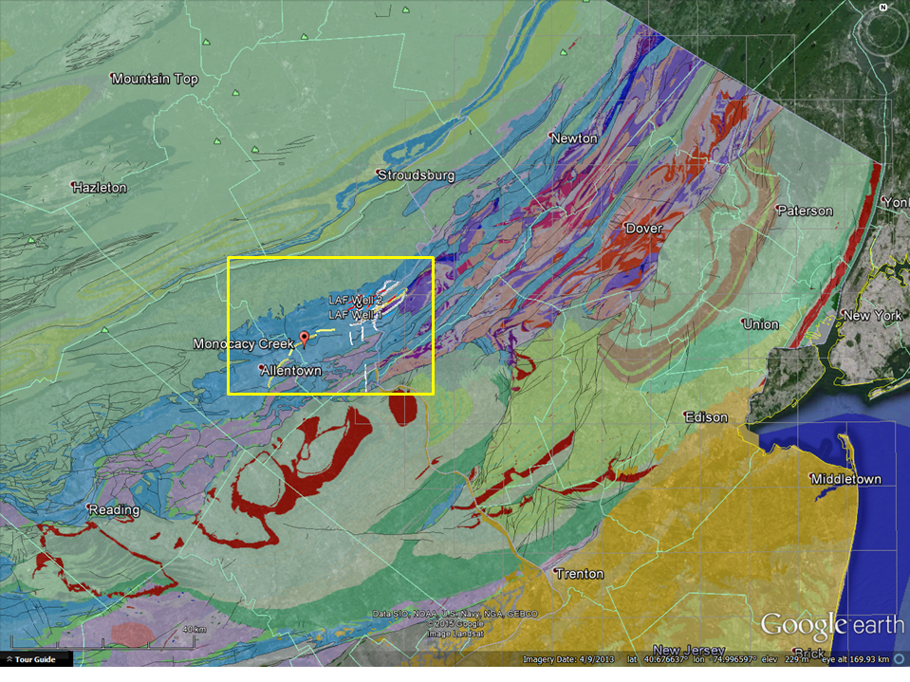

Slide 3
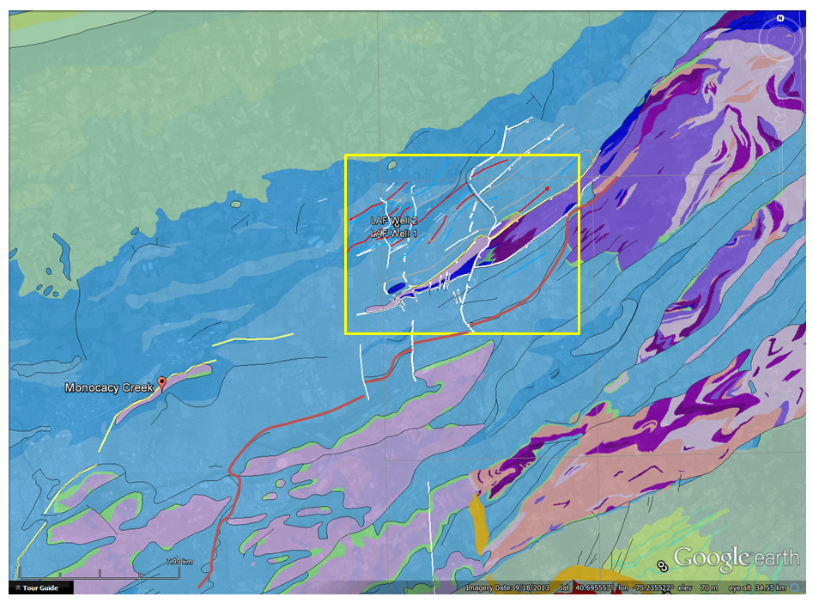

Slide 4
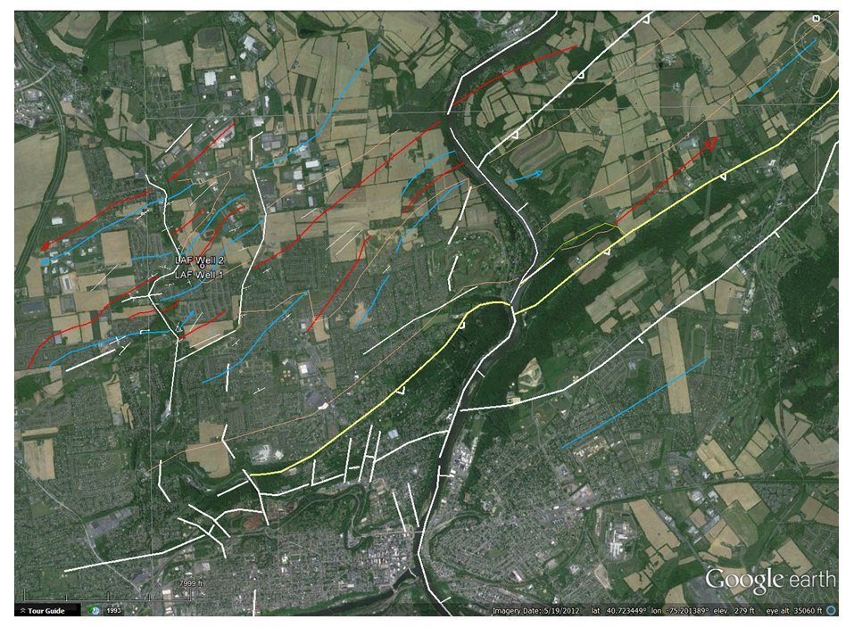

Slide 5
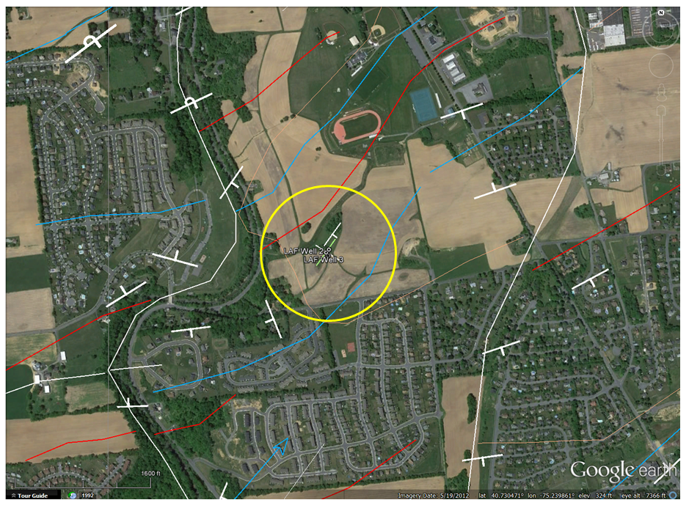

Slide 6
Identification | Geographic coordinates (WGS84 - decimal degrees) |  | Elevation NGVD88 – feet (meters)
Name | Longitude | Latitude | Land surface | Stickup | Casing depth | Borehole depth | GE Model Altitude
LAF Well 1 LAF Well 2 LAF Well 3 | -75.240540° -75.240508° -75.240628° | 40.730417° 40. 730618° 40.730521° | 319 (97.3) 317 (96.6) 316 (96.3) | 2.0 (0.60) 2.0 (0.60) 2.0 (0.60) | 18.3 (5.6) 19.2 (5.9 ) 18.2 (5.5 ) | 110.5 (33.7) 104.0 (31.7) 117.0 (35.7)

Slide 7
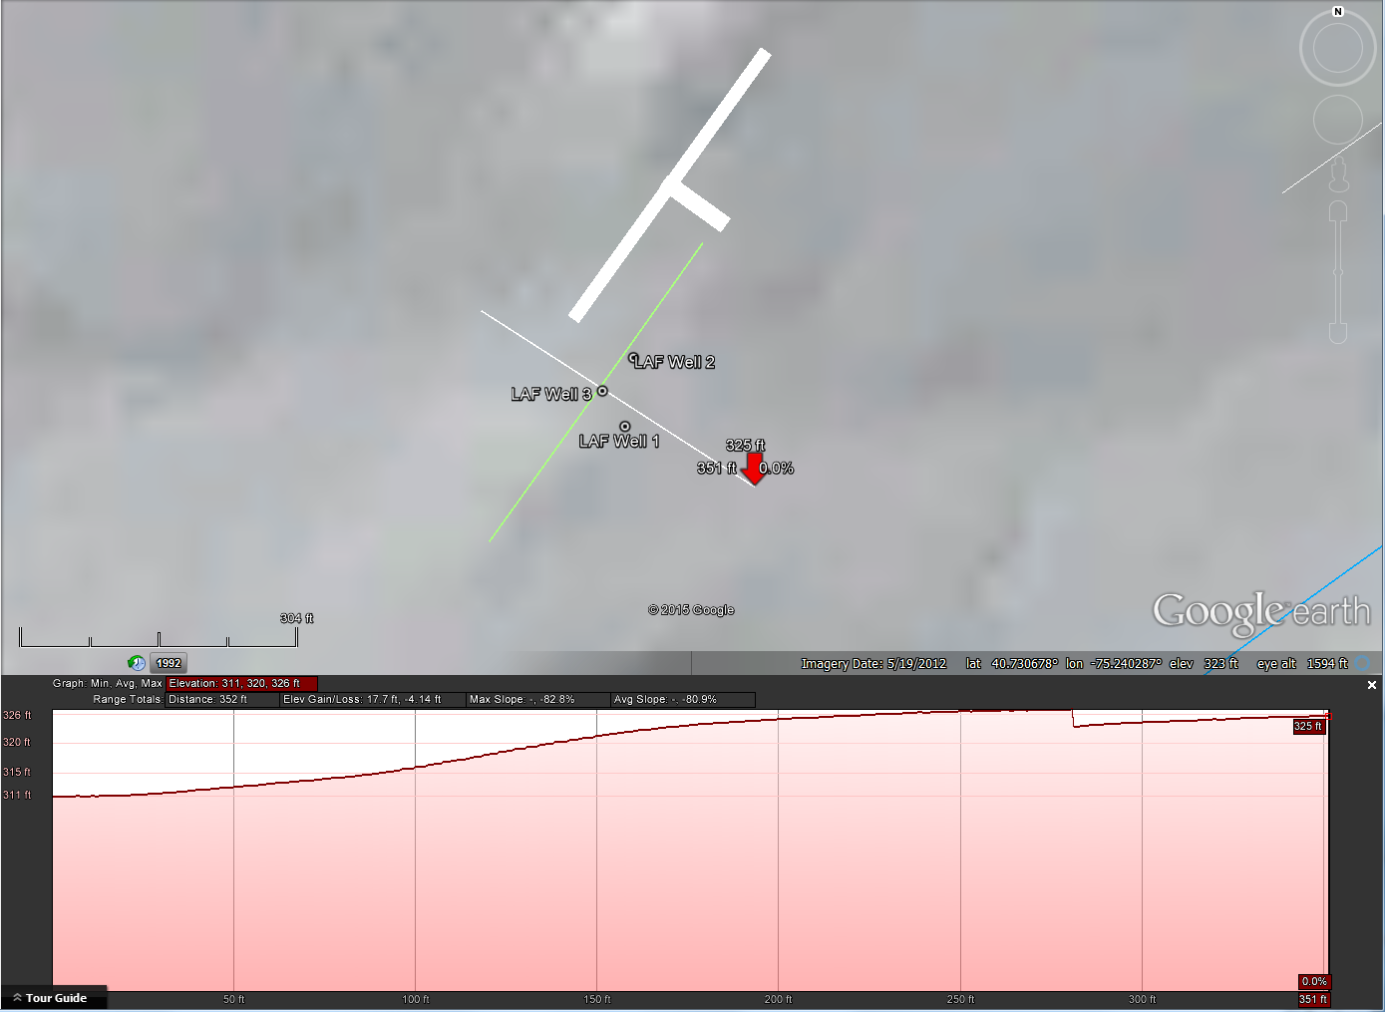

Slide 8
Horizontal = 50 ft = 1.3 in. and Vertical 5 ft = 0.22 in. or 50 ft 2.2 in., therefore 1.3/2.2= 0.59

Slide 9
Well 3
Well 1
Well 2

Slide 10
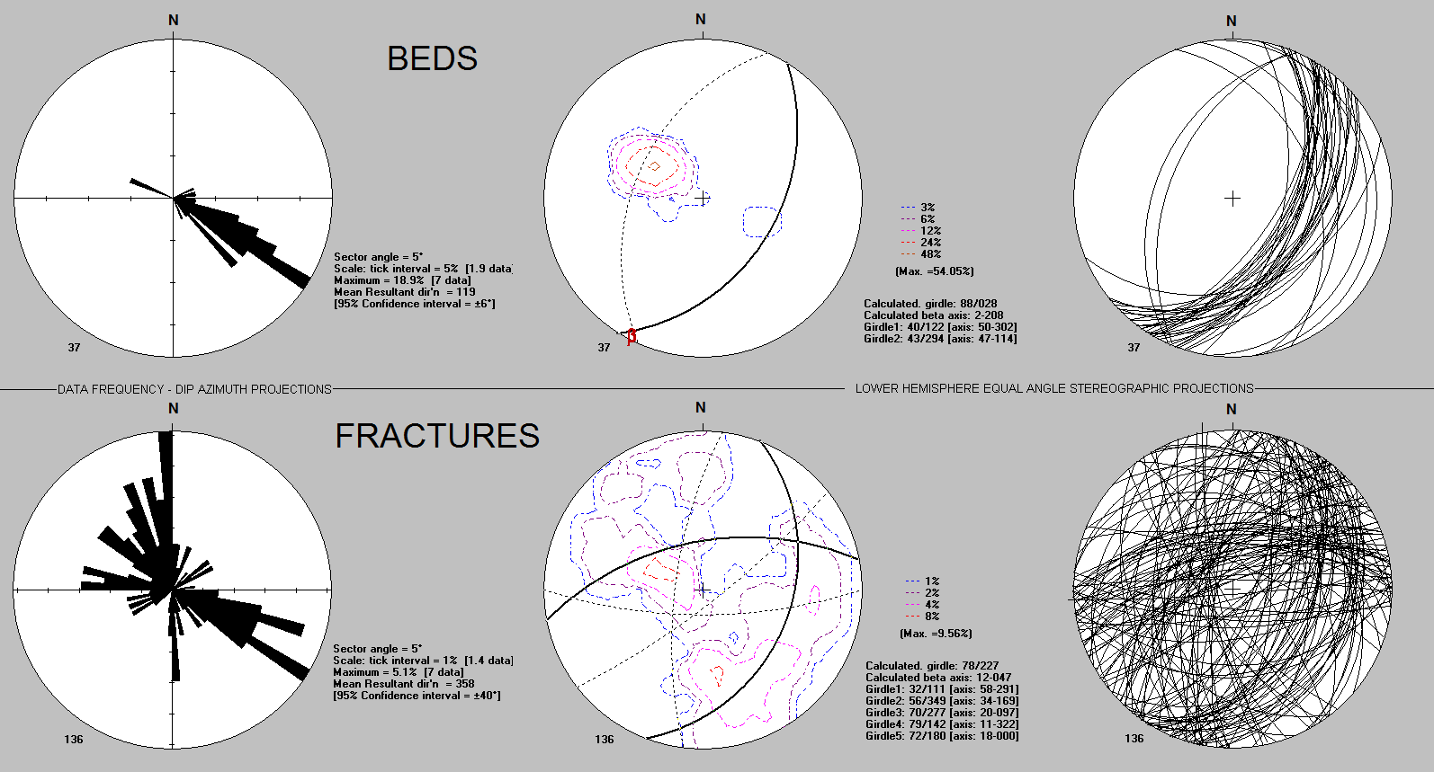
Section azimuth: 122 Beds: primary 40/122 and rarely 43/294
Fractures: 32/111 8% 70/277 4% 79/142 2% 56/349 8% 72/180 2%

Slide 11
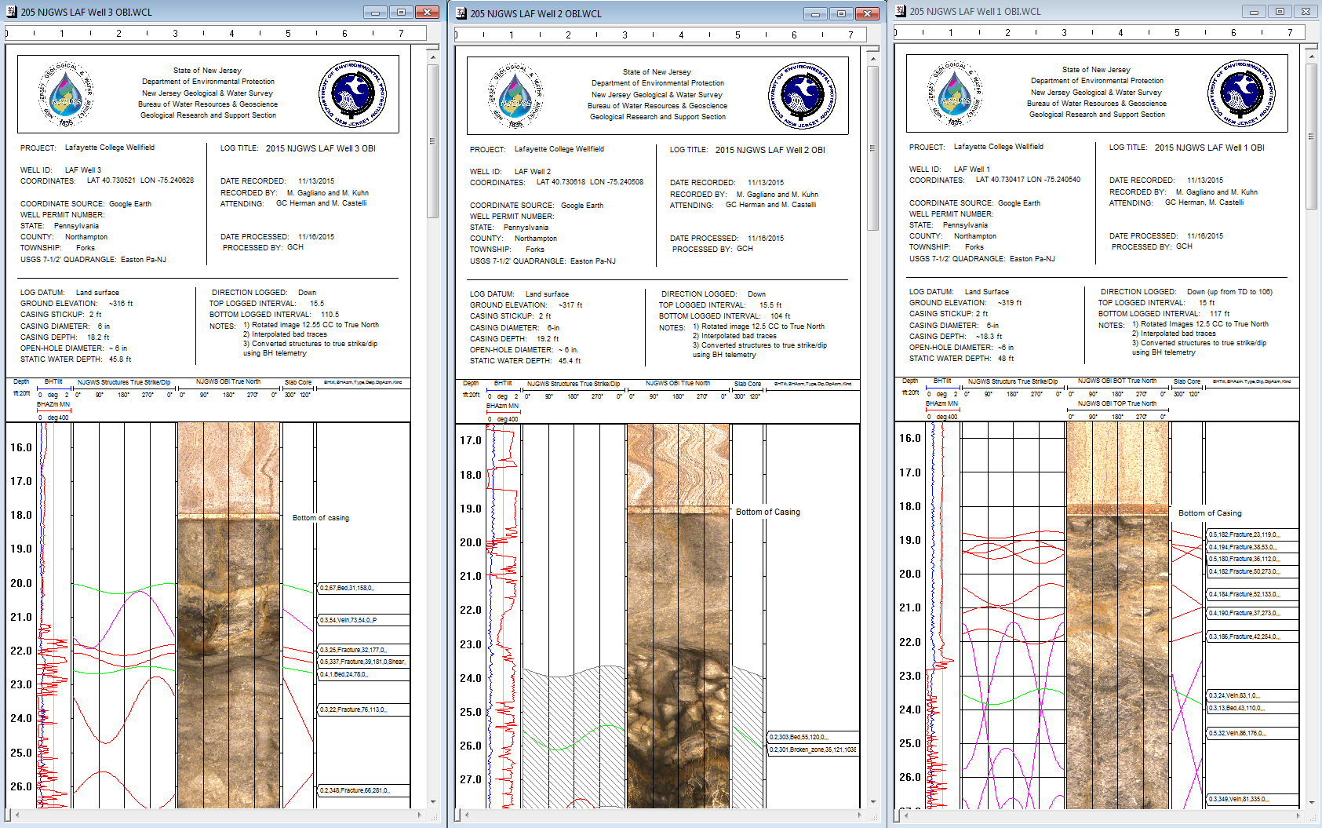
NW WELL 3 WELL 2 WELL 1 SE

Slide 12
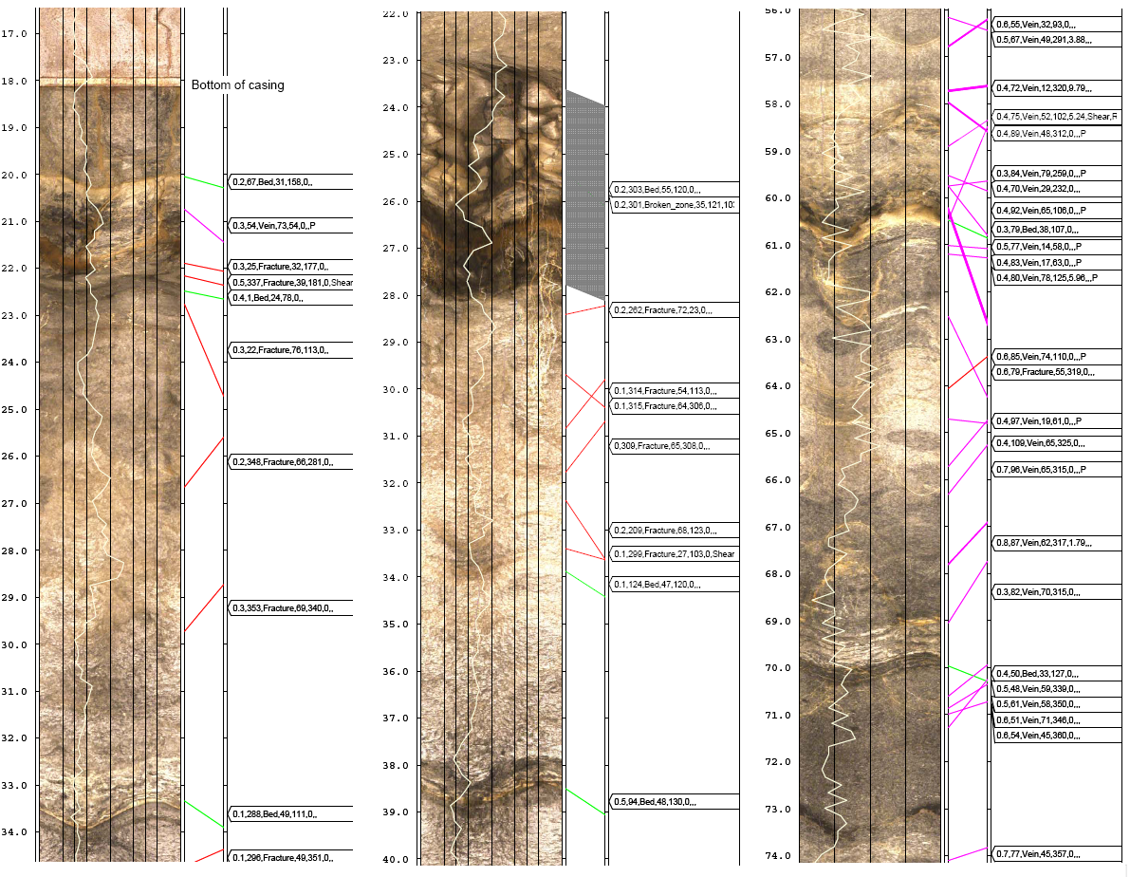
NW WELL 3 WELL 2 WELL 1 SE
MH 1

Slide 13
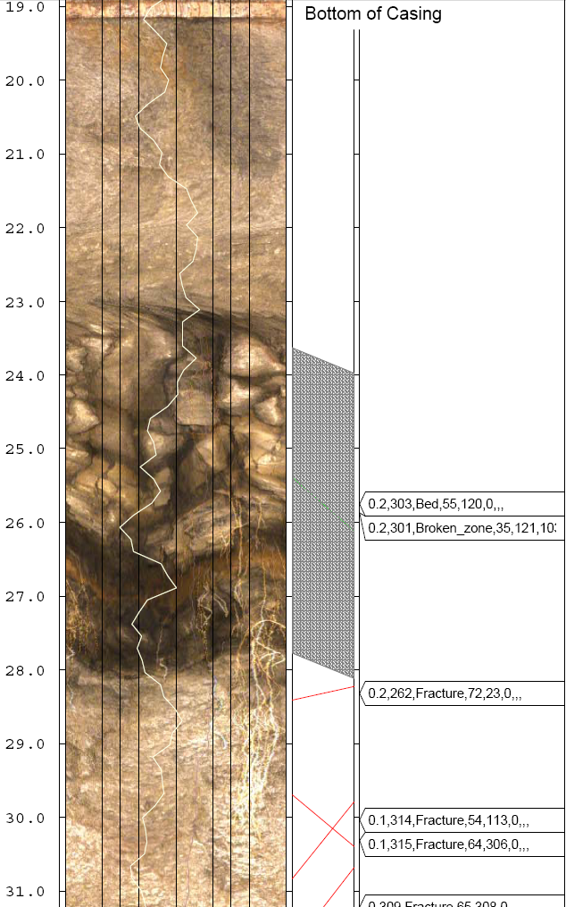
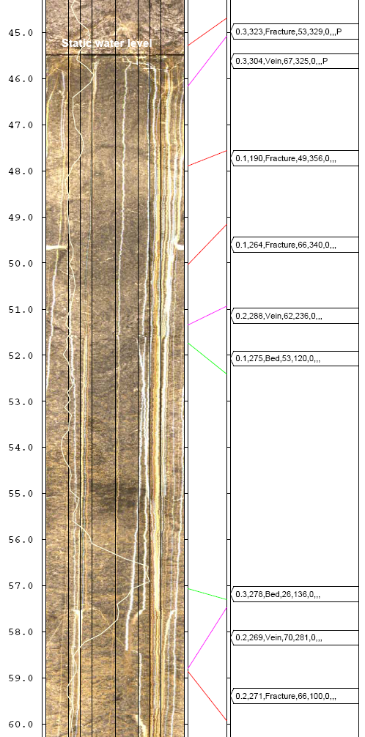
WELL 2 Karst zone with plant roots WELL 2 Mineralized flow streaks

Slide 14
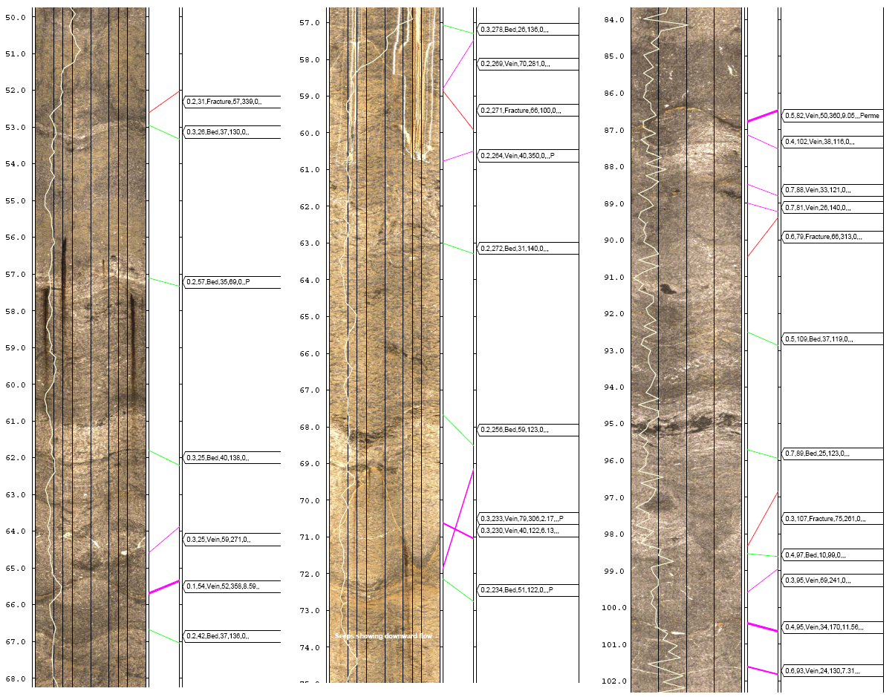
NW WELL 3 WELL 2 WELL 1 SE
MH 2

Slide 15
HYDROGEOLOGICAL PROFILE BASED ON OBI IMAGERY LAFAYETTE COLLEGE WELLFIELD, EASTON, PENNSYLVANIA
Ordovician Beekmantown Dolomite
SE
Well 3
~ 40ft
NW
Well 2
Well 1
320
WEATHERED BEDROCK
300
WEATHERED BEDROCK
21 ft
40º
26 ft
280
water table
45.8 ft
45.5 ft
48 ft
Elevation (feet - mean sea level)
61 ft
SYNCLINE HINGE ~ 600’ SE
260
ANTICLINE HINGE ~ 500’ NW
61 ft
68 ft
MH1
240
MH2
220
95 ft
TD 111
TD 104
TD 114
Cross-section azimuth = 123-303º
FEATURE APPARENT DIP/DIP AZIMUTH
DIP
Bedding 40 40/122 43 43/294
Fractures 31 32/111 (8%)
40 56/349 (8%)
68 70/277 (4%)
78 79/142 (2%)
58 72/180 (2%)
BED & FRACTURE GEOMETRY
APPARENT DIP (AD) = COT ((TAN (DIP) * COS (a)) where a = acute deviation between the cross-section azimuth and a structure’s dip azimuth
NOTES:
G.C. Herman, NJ Geological & Water Survey November, 19, 2015

Slide 16
Lafayette College Well-field Analysis
Holding place for 3D well-field GE Model

